Slide 1
Facility renovation and modernization. Increasing capacity from one building to four, state of the art auditorium
Stakeholder Analysis
PROF. MICHAEL COBB
TEAM: A-SQUARE
ADITHYA.A
ARAVIND.K

Slide 2
QUICK INTRODUCTION…
PROJECT – LINCOLN HALL RENOVATION
PROJECT TAKEN UP BY – A&A CONSTRUCTION LLC.
CONSTRUCTION OF THIS BUILDING WAS MADE ON 1960 AND CHANGES NEED TO BE DONE.

Slide 3
Stakeholder
Definition: stakeholder is a person or group or organization who can influence or can be influence by the project
Benefits of stakeholder analysis:
Improvements in the project by the brainstorming between stakeholders
Feedback on the ongoing project
Financial and technical support from key stakeholder

Slide 4
LIST OF STAKEHOLDERS & ROLES…..
ROLE | NAME
Project Sponsor | Bill Clinton
Project Review Group | Donald Trump
Project Manager | Hillary Clinton
Quality Manager | Mike Cobb
Procurement Manager | Rajesh Chhetry
Communications Manager | Aditya Adibhatta
Project Office Manager | Aravind Kumpatla
Civil Engineer | Thomas jefferson
Architectural Technician | Peterson
CAD or computer-aided design and drafting (CADD) Operator | Mark
Construction Technician | Jon Doe
Roofing Technician | Manaswi
Public
Sound technician | Layman
I.T. technician | Steve
.

Slide 5
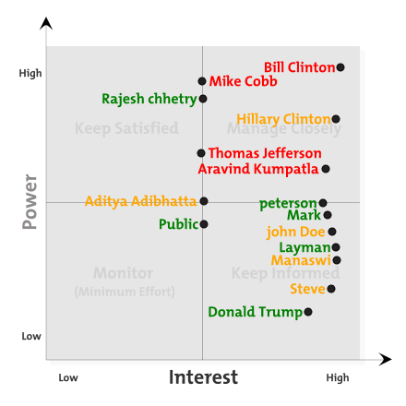
POWER/INTEREST GRID

Slide 6
THANK YOU
.

